Slide 1
Lecture 3 The Production Possibilities Frontier

Slide 2
The Production Possibilities Frontier
The Production Possibilities Frontier
The production possibilities frontier shows the combinations of two goods (output) that the economy can possibly produce given the available factors of production and the available production technology.
We use production possibilities frontier to illustrate some basic economic ideas such as scarcity, tradeoffs, choice, opportunity costs, efficiency, inefficiency, economic growth etc.
Although real economies produce thousands of goods and services, we assume an economy that produces only two goods – jutes and computers.

Slide 3
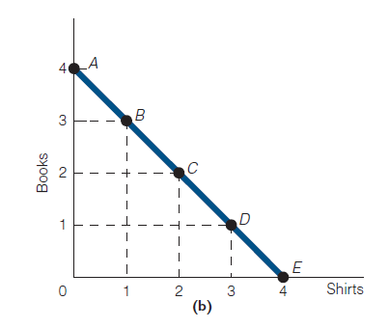
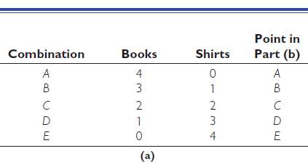
The Production Possibilities Frontier
The Straight-Line PPF: Constant Opportunity Costs

Slide 4
The Production Possibilities Frontier
The Straight-Line PPF: Constant Opportunity Costs
The line that connects points A–E is the production possibilities frontier.
Notice that the production possibilities frontier is a straight line. This is because the opportunity cost of books and shirts (in our example) is constant.
Straight-line PPF = Constant opportunity costs

Slide 5
The Production Possibilities Frontier
The Straight-Line PPF: Constant Opportunity Costs
To illustrate what constant opportunity costs means, suppose the economy were to move from point A to point B.
At point A, 4 books are produced and 0 shirts; at point B, 3 books are produced and 1 shirt.
What does the economy have to forfeit (in terms of books) to get 1 shirt?
The answer is 1 book. We conclude that moving from point A to point B, the opportunity cost of 1 shirt is 1 book.

Slide 6
The Production Possibilities Frontier
The Straight-Line PPF: Constant Opportunity Costs
Now let’s move from point B to point C. At point B, 3 books and 1 shirt are produced; at point C, 2 books and 2 shirts are produced.
What does the economy have to forfeit (in terms of books) to get another shirt?
The answer is 1 book. We conclude that moving from point B to C, the opportunity cost of 1 shirt is 1 book.
In fact, when we move from C to D or from D to E, we also notice that the opportunity cost of 1 shirt is 1 book.

Slide 7
The Production Possibilities Frontier
The Straight-Line PPF: Constant Opportunity Costs
This is what we mean when we speak of constant opportunity costs: The opportunity cost of 1 shirt is always 1 book.
And because of constant opportunity costs, the PPF in Exhibit 1(b) is a straight line.
When opportunity costs are not constant, the PPF will not be a straight line.

Slide 8
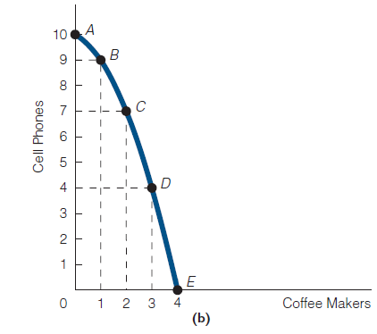
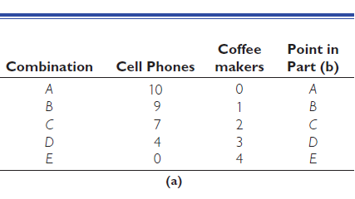
The Production Possibilities Frontier
The Bowed-Outward (Concave-Downward) PPF: Increasing Opportunity Costs

Slide 9
The Production Possibilities Frontier
The Bowed-Outward (Concave-Downward) PPF: Increasing Opportunity Costs
In this case, the production possibilities frontier is bowed outward (concave downward) because the opportunity cost of coffee makers increases as more coffee makers are produced.
Bowed-outward PPF = Increasing opportunity costs
To illustrate, let’s start at point A, where the economy is producing 10 cell phones and 0 coffee makers and move to point B, where the economy is producing 9 cell phones and 1 coffee maker.

Slide 10
The Production Possibilities Frontier
The Bowed-Outward (Concave-Downward) PPF: Increasing Opportunity Costs
What is the opportunity cost of a coffee maker moving from point A to point B?
The answer is 1 cell phone.
Now let’s move from point B to point C. At point B, the economy is producing 9 cell phones and 1 coffee maker; at point C, the economy is producing 7 cell phones and 2 coffee makers.

Slide 11
The Production Possibilities Frontier
The Bowed-Outward (Concave-Downward) PPF: Increasing Opportunity Costs
What does the economy have to forfeit (in terms of cell phones) to get 1 additional coffee maker?
The answer this time is 2 cell phones.
We conclude that moving from point A to B and from B to C, the opportunity cost increases.
If we were to continue producing additional coffee makers, we would see that we would have to give up increasingly more cell phones.

Slide 12
The Production Possibilities Frontier
Law of Increasing Opportunity Costs
In the real world, most production possibilities frontiers are bowed outward. In other words, for most goods, the opportunity costs increase as more of a good is produced.
This is referred to as the law of increasing opportunity costs.
The opportunity costs increase as more of most goods is produced because people have varying abilities and factors of production are not perfectly substitutes.
Exhibit 3 summarizes this points.

Slide 13
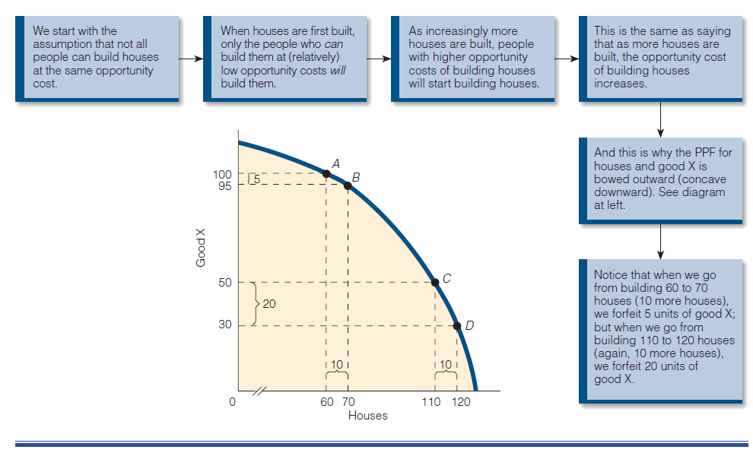
The Production Possibilities Frontier
Law of Increasing Opportunity Costs

Slide 14


Slide 15
Thank You

